Slide 1

SMART LAB USING IOT
SUBMITTED BY:-
PROJECT GUIDE :
Mr.Lakshman K. T.R.Akhil (2013/B/11)
Apurv Rathore (2013/B/42)

Slide 2

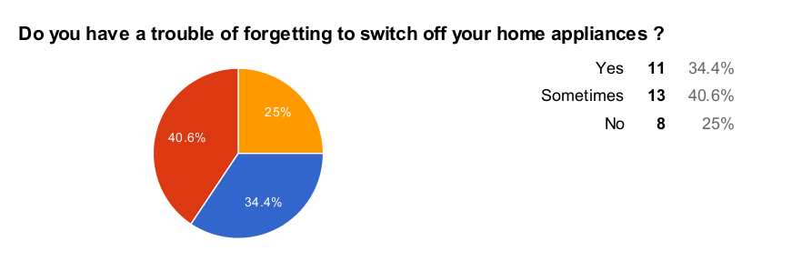
Why this project ...??
Do you have a trouble of forgetting to switch off your home /lab appliances?

Slide 3
Literature Survey
Madakam S., Ramaswamy R. & Tripathi S. (IoT) all these analysts made points on Introduction, Methodology, Reviewing Products on IoT.
Nunberg G.(2012) The Advent of Internet has also done a journal which actually leaded to a new journal in 2015 by Butler D.
Lombreglia R.(2015) is rated one of the best journals as he explains the same points but in a very easy and layman’s language.

Slide 4
Main Ideas
Lab Automation
2. Internet of Things

Slide 5
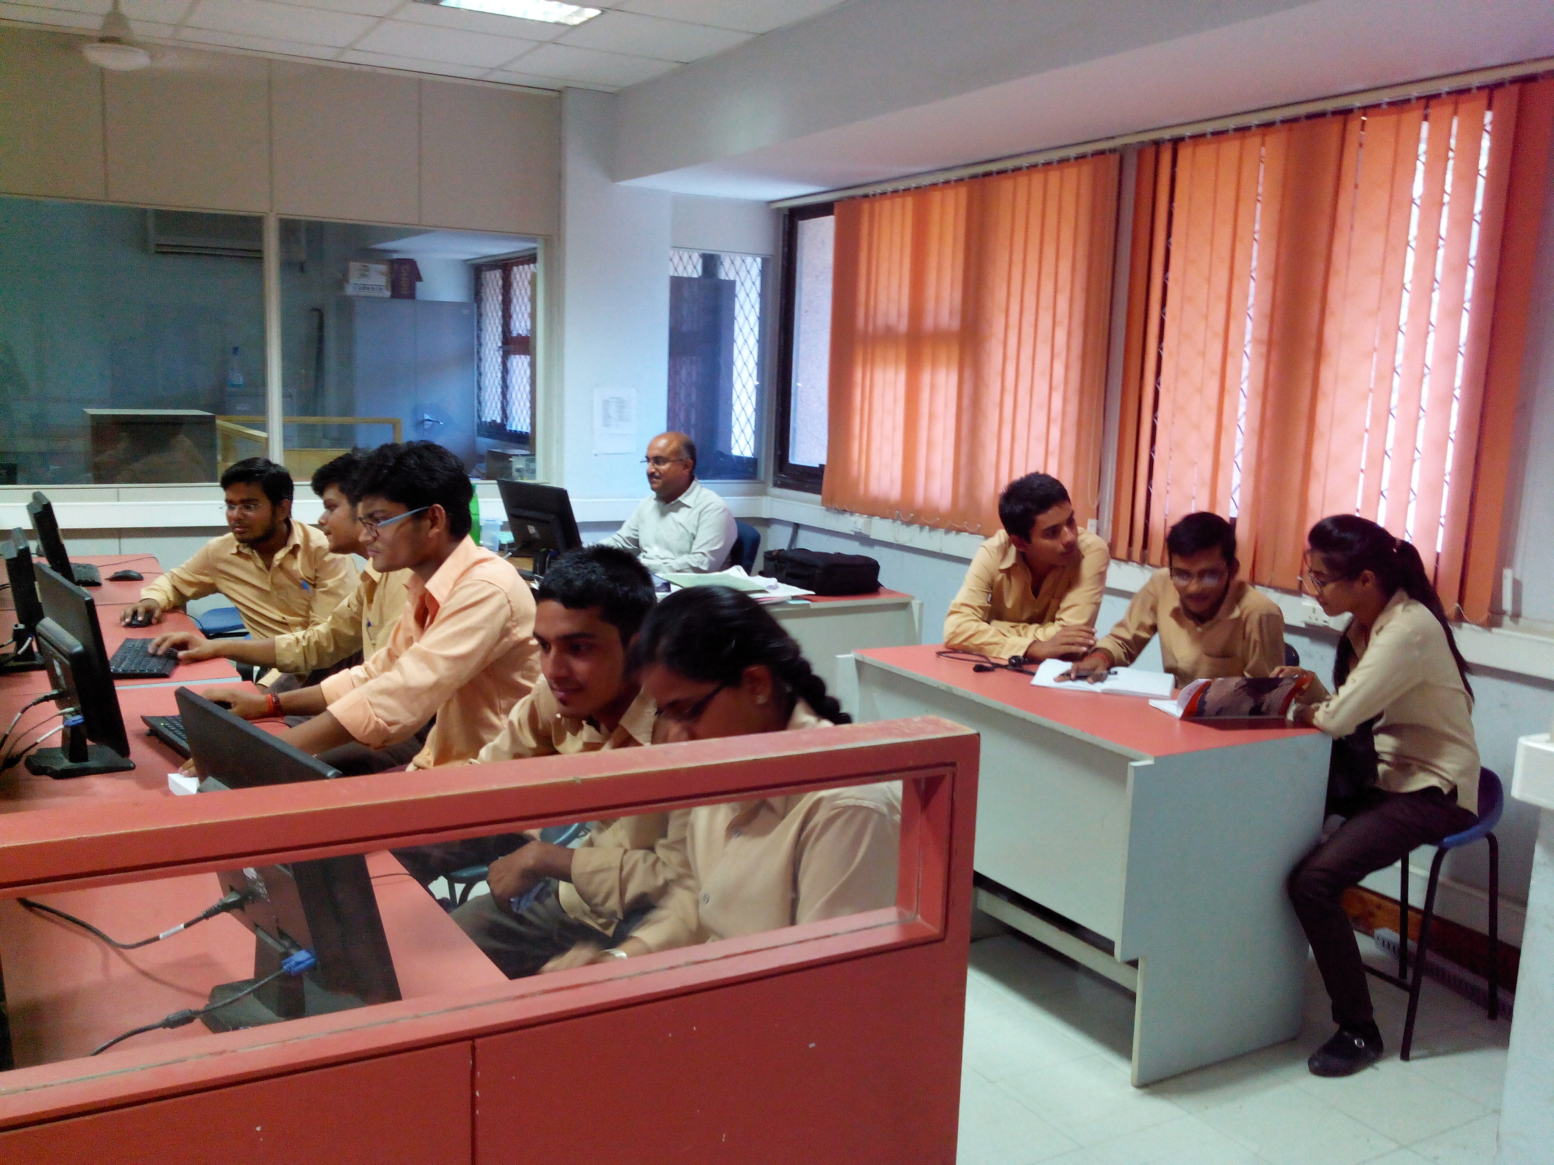
Lab Automation
Automation of Smart Labs like MCC,SDL lab.
Simplicity
Affordability

Slide 6
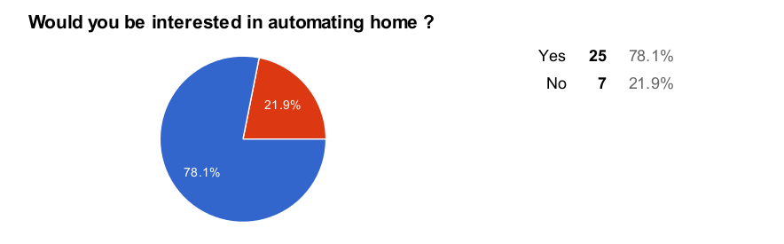
Is it needed …..?
Would you be interested in automating labs in collage?

Slide 7
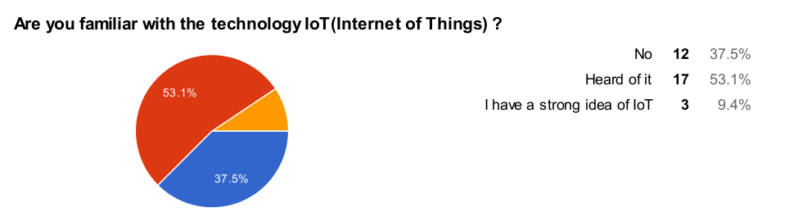
IoT - Is it something new ?

Slide 8
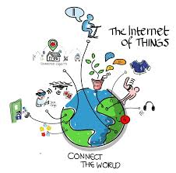
Internet of Things
A scenario in which objects, animals or people are provided with unique identifiers
and the ability to transfer data
over a network without requiring
human-to-human or human-to-
computer interaction.

Slide 9
System Functions
To control lighting, air conditioning, appliances, communication systems, entertainment and home security devices.
To improve Convenience, Comfort, Energy efficiency and Security.

Slide 10
System Features
Wireless Connectivity
Expansion Capability
Protocol Compatibility
Application Control
Device Management
Savings
Convenience

Slide 11
Block Diagram
C
O
N
T
R
O
L
L
E
R
RELAY 1
Wi- Fi
MODULE
RELAY
DRIVER
RELAY N

Slide 12
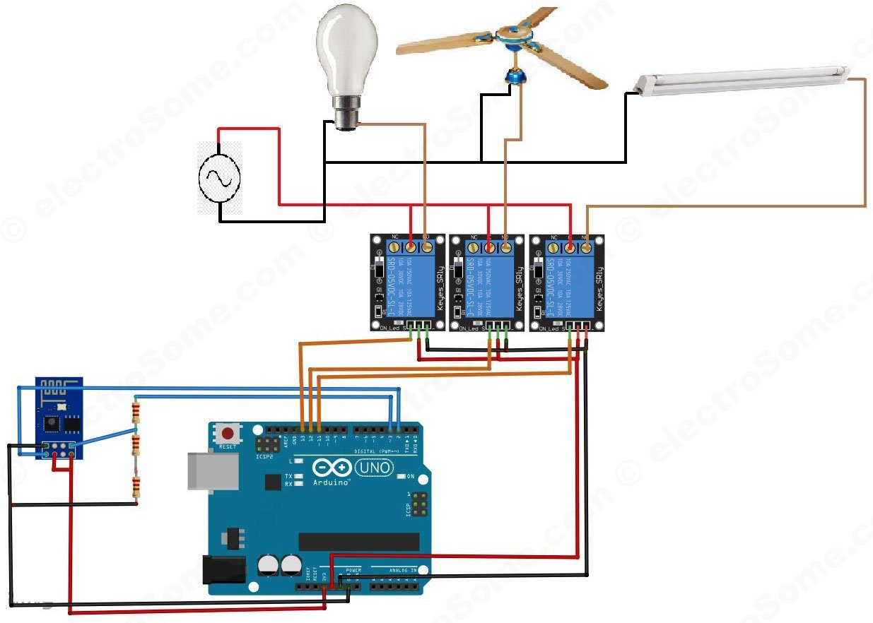
Circuit Diagram

Slide 13
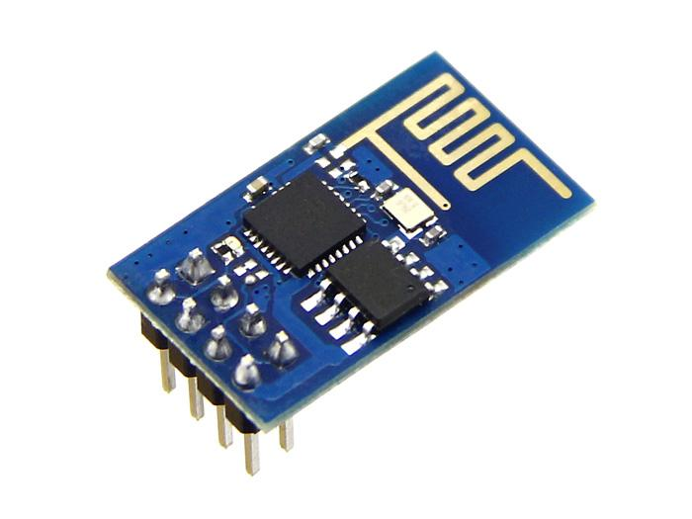
Product Components
ESP8266 Wifi module
1 per Room*

Slide 14
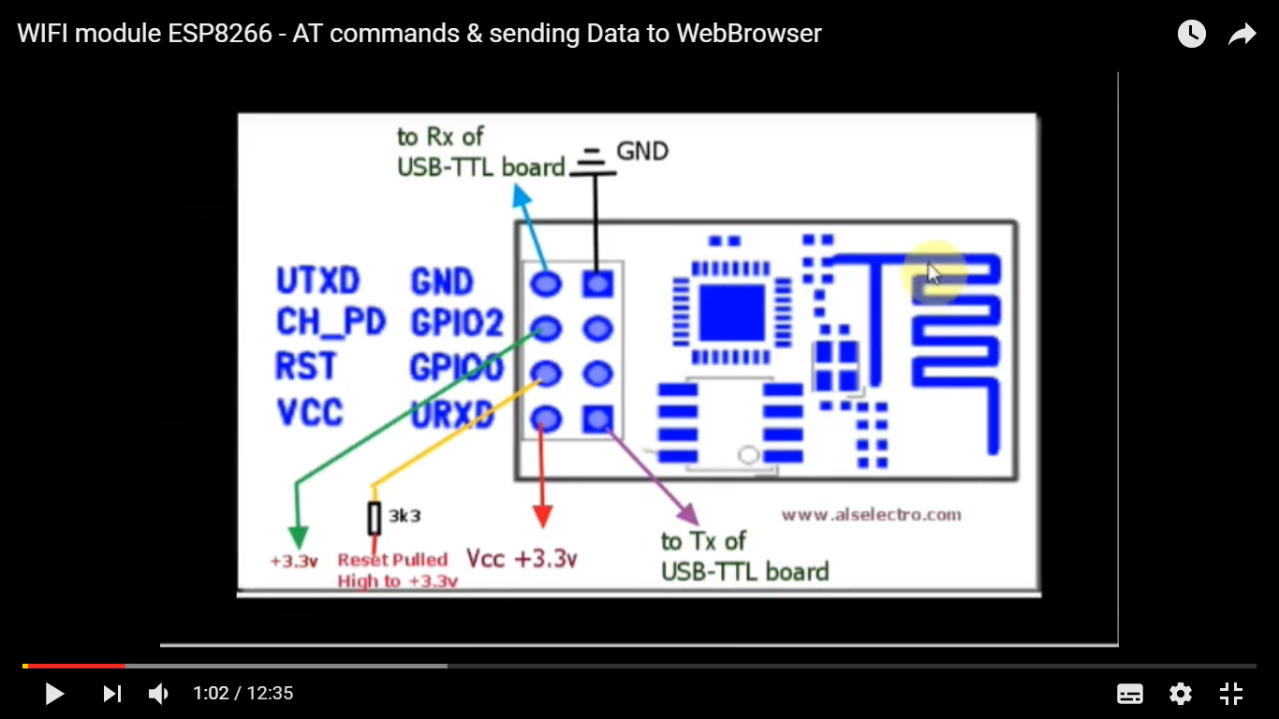
ESP8266

Slide 15
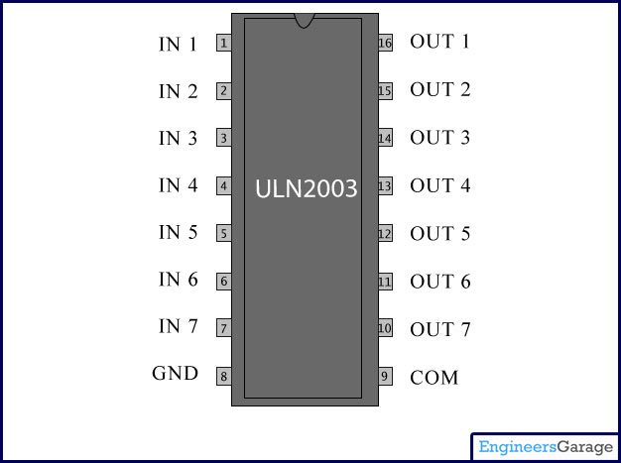
Relay Driver:ULN2003
2 relay drivers have been used to control 10 relays, 5 relays from each driver. As there are 10 relays so 10 AC loads can be controlled.

Slide 16
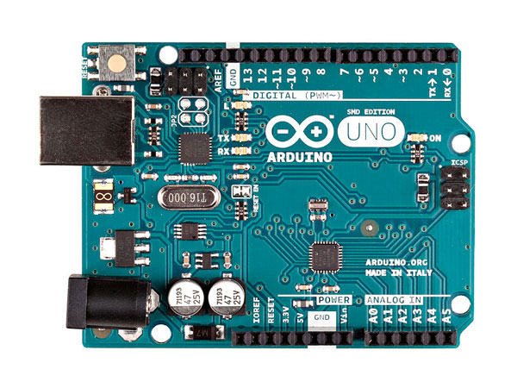
ARDUINO
It is 8 bit microcontroller.
It operates on 5V power supply.
It operates on 16MHZ crystal frequency.
It has on chip 64 KB flash memory.
On chip serial is available.
It has 54 I/O ports.

Slide 17
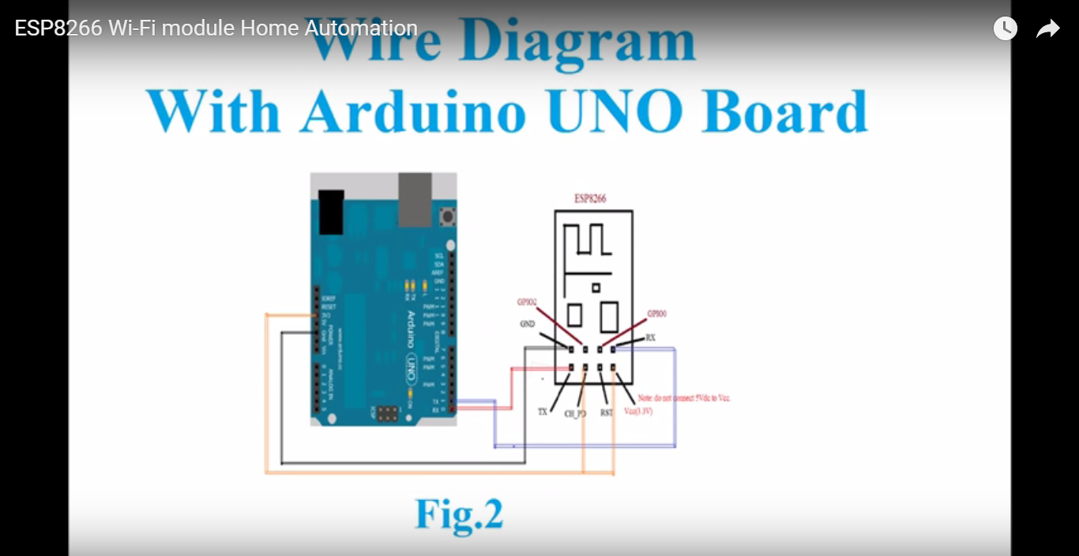

Slide 18
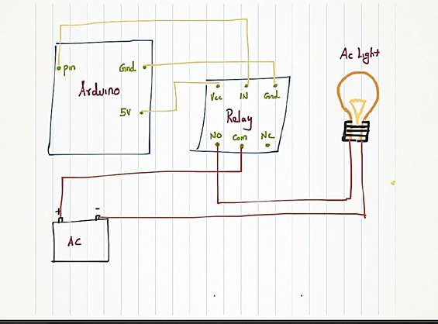
Relay Module with Arduino:
For controlling AC load by Arduino .
6
19

Slide 19
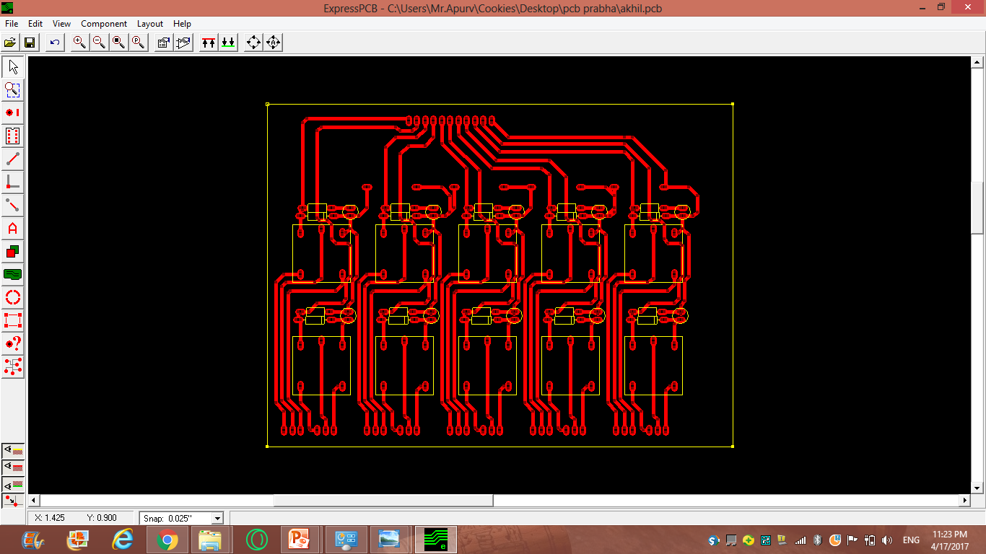
PCB Artwork

Slide 20
Weeks | Nov | Dec | Jan | Feb | March | April
1st week | Literature survey | Presentation | Web page interface | Study of Arduino in detail | Purchasing of components | Debugging circuit
2nd week | Synopsis Formation | Overview of Arduino software | Study of all the real-time problems | Programming | Testing of components | PCB Designing
3rd week | Requirement analysis | Architectural diagram formation | Interfacing study | testing | Designing crcuit | PCB Fabrication
4th week | Requirement analysis | Simulation on software | Circuit diagram | debugging | testing of circuit | placement and soldering circuit
Notes:
Project scheduling

Slide 21
Future Scope

Slide 22
References
www.efy.com
www.engineersgarage.com
www.instructables.com
www.electrosome.com

Slide 23
Thank you .........

